Slide 1
SaaS

Slide 2
Software-as–a-Service (SaaS) model allows to provide software application as a service to the end users
It refers to a software that is deployed on a host service and is accessible via Internet.

Slide 3
Characteristics
SaaS makes the software available over the Internet.
The software applications are maintained by the vendor.
The license to the software may be subscription based or usage based.
SaaS applications are cost-effective since they do not require any maintenance at end user side.
They are available on demand.
They can be scaled up or down on demand.
They are automatically upgraded and updated.
SaaS offers shared data model. Therefore, multiple users can share single instance of infrastructure.

Slide 4
The SaaS application deployment requires a little or no client side software installation, which results in the following benefits:
No requirement for complex software packages at client side
Little or no risk of configuration at client side
Low distribution cost
Multitenant solutions

Slide 5
Issues
Browser based risks
Network dependence
Lack of portability between SaaS clouds
Dependability
Robustness

Slide 6
Open SaaS
Open SaaS uses those SaaS applications, which are developed using open source programming language. These SaaS applications can run on any open source operating system and database. Open SaaS has several benefits listed below:
No License Required
Low Deployment Cost
More portable applications
More Robust Solution

Slide 7
Varieties of Software as a Service
Vertical SaaS
This is the software which manages the demand of a particular organization. This can be software for healthcare, agriculture, real estate, finance industries.
Horizontal SaaS
This is the product which concentrates on the software such as marketing, tools, Human Resource, and many more.

Slide 8
Advantages of SaaS
Easy to use
Cheap
Scalability
Less prone to data loss since data is being stored in the cloud.
SaaS applications are less clunky. do not require users to install/uninstall binary code on their machines.
Due to the delivery nature of Sass through the internet, SaaS applications are able to run on a wide variety of devices.

Slide 9
Disadvantages of SaaS
Robustness
Privacy
Security
Reliability

Slide 10
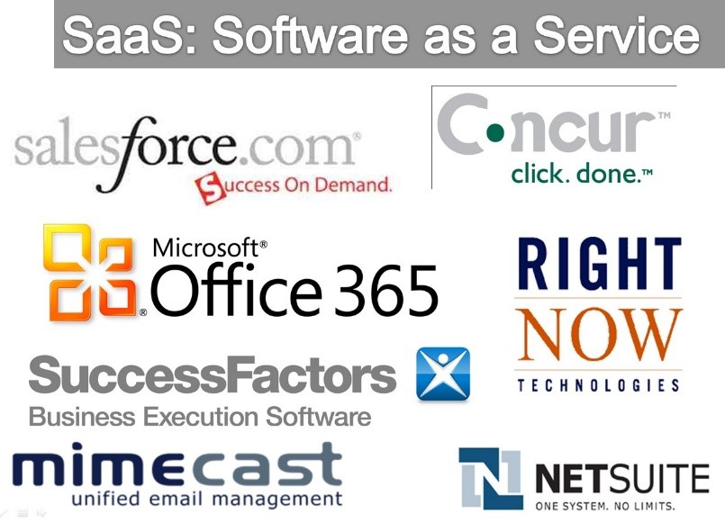
SAAS service providers
Salesforce
Office 365
Dropbox
Google G suite
Zoom
SAP Concur

Slide 11
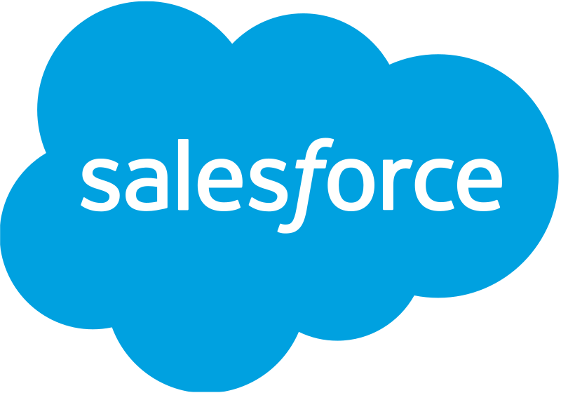
“Salesforce Architect has the highest average salary across the most valuable job skills.”
– Business Insider
Salesforce CRM is a cloud-based software that helps organizations to effectively streamline their sales and marketing operations.

Slide 12
- An immense impact on the world of computing
- Fifth-largest software company
CRM centric
Now provides various software solutions and a platform
Recall Cloud computing benefits
- Replacing the lengthy installation process and moving everything to the internet.
50-dollar monthly subscription fee.
Team can use it from anywhere with access to the internet
Salesforce seamlessly integrates with 3rd party apps.
Subject to a phishing attack

Slide 13
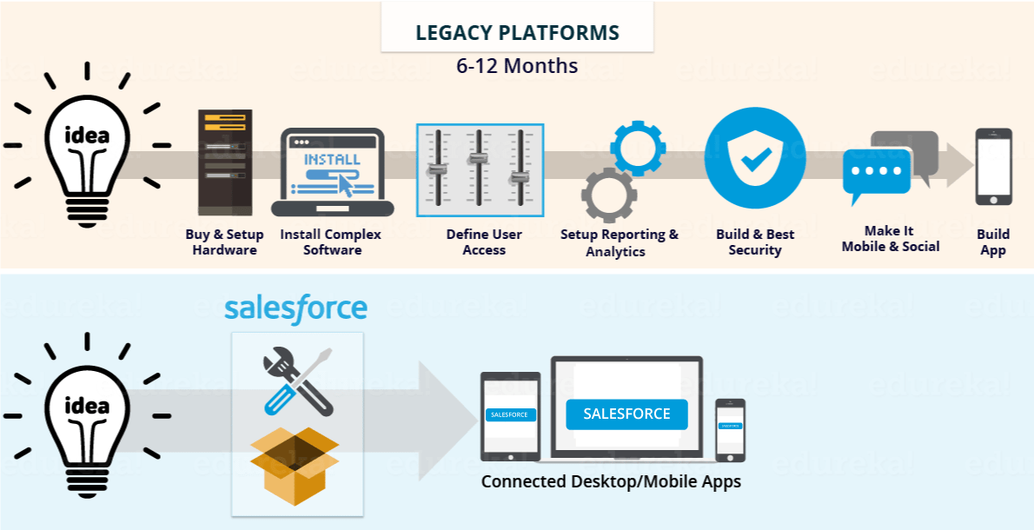

Slide 14
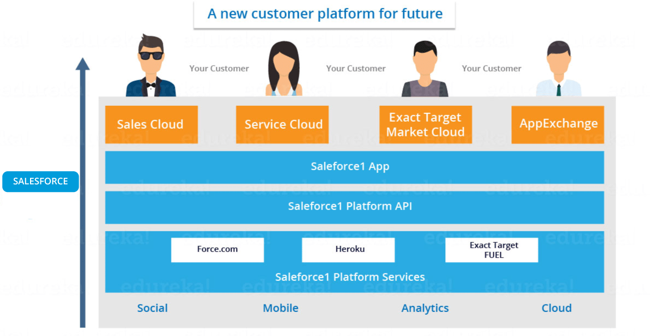
Salesforce Offers

Slide 15
Salesforce Sales Cloud – CRM platform that enables you to manage your organization’s sales, marketing and customer support facets.
Salesforce Marketing Cloud – powerful digital marketing platforms.
Salesforce Service Cloud – service platform ; features like case tracking and social networking plug-in for conversation and analytics.
Salesforce Community Cloud – social platform
Chatter – enterprise collaboration platform from Salesforce that enables employees to collaborate.

Slide 16
Salesforce App Cloud – To develop custom apps that will run on the Salesforce platform, you can use the Salesforce App Cloud. It provides you with a collection of development tools that you can utilize to create custom applications. Some of the tools in the App Cloud include:
Force.com, allows admins and developers to create websites and applications into the main Salesforce.com application.
AppExchange is an online application marketplace for third-party applications that run on the Force.com platform.
Heroku Enterprise gives developers the flexibility to create apps using their preferred languages and tools.
Salesforce Thunder is big data and rules processing engine designed to analyze events and take personalized actions.
Salesforce Sandbox allows developers to test ideas in a safe and isolated development environment.

Slide 17
Industry | Case
Communications | Comcast-Spectator used Salesforce to maintain detailed customer profiles so that they can identify their biggest fans and market more effectively to them.
Financial Services | American Express started to use Salesforce Sales Cloud in 2010.
Government | Staff of Obama for America used Salesforce Service Cloud to send personalized emails to users. They also used dashboards to get real-time read on what the nation was thinking about and where opinions differed across the country.

Slide 18
Industry | Case
Health Care | with Salesforce App Cloud, they can easily view and update patient data, coordinate with physicians and find effective community resources.
High Tech | Sony uses Salesforce Service Cloud to tune in with its customers.
Retail | Trip A Deal’s Heroku based cloud platform application was designed and deployed in under five weeks. This delivered critical advantages to the start up business including system stability and cost effective scalability.

